Slide 1

IE9 Pinned Sites
Level: 200
St. Louis Day of .NET - 2011

Slide 2
Contact Information
Geeks with Blogs - geekswithblogs.net/scottkuhl/
Twitter - @scottkuhl
Google - profiles.google.com/scottkuhl/
Email – scott@kuhl.ws

Slide 3
Overview
What are Pinned Sites
Why do you care?
Pinify
High Resolution Icons
Jump Lists
Notifications
Preview Controls
Notification Bar
Google Analytics
Gallery

Slide 4
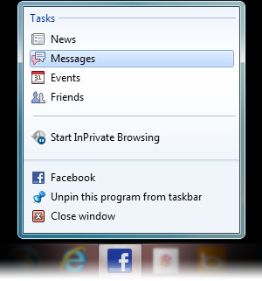

IE9 Pinned Sites
First step to web native
Taskbar
Look and Feel
More to come in Windows 8
Fighting for space
Notes:
DEMO
Pin IMDb

Slide 5
Browser Stats
IE still has the greatest market share, apx. 45%
IE usage is falling
IE9 is only apx 16% of all IE usage
IE9 usage is increasing
IE9 overall market share is apx. 7%
Notes:
Over the next year apx 20% market share
Just because IE is not the primary browser does not mean users won’t use IE to pin sites

Slide 6
Scenarios
Web Sites | Web Apps | Line of Business
Immersion | Integration | Integration
Frequency
IMDB.com | Hotmail | CRM
Hardest | Harder | Easiest
Notes:
Web Sites: You are competing with some of the most popular sites on the web. Only dedicated followers will pin.
Web Apps: You need to create a web app people will use frequently. Right now its all about mobile apps.
LOB: You are creating a requested app by a defined set of users. More likely they will use it often and features can be a real benefit.

Slide 7

Pinify
ie9ify.codeplex.com
Open Source
jQuery Plugin
Easy Got Easier!
Notes:
Handles browser checks for you.
Will use this throughout the sample.
DEMO
Show scripts/jquery.pinify.min.js
Show site.master
Linked in (Line 12)
Determine if site is pinned (Line 16) window.external.msIsSiteMode() is an IE only method
Scripts/jquery.pinify.min.js
Header of site.master

Slide 8
Icons
High resolution, should be at least 32 x 32
iconspedia.com
fiverr.com (erickarl)
Paint.NET + Build My Pinned Site
Notes:
DEMO
Show iconspedia.com
Show fiverr.com
Show buildmypinnedsite.com
Show img/favicon.ico
site.master
Show linked in (Line 9)
Run and pin the site

Slide 9
Static Tasks
Used for Fixed Lists, Common Areas, Menu
Set Name, Action, Icon
Notes:
DEMO
Show site.master
(Line 36)
Finds the head element
Sets the starting URL (You can pick a different page designed for IE9)
Set each of the static tasks
Show site.master.cs
(Pinify Method)
Sets link and icon variables (Line 35) (Could be done in JavaScript)
Show links on pinned site

Slide 10
Dynamic Jump Lists
Used for Changing Lists, Personalized, Current Info
Set Group Title
Set each Name, URL, Icon
Notes:
DEMO
site.master - Add the jump list (Line 53)
site.master.cs – Build the javascript array in code behind (Line 41) (Could be done in JavaScript)
Show links in pinned site

Slide 11
Notifications
Grab a user’s attention
Icon overlay, Counts, Flashing
Only works while the site is active
Notes:
DEMO
site.master
Page Load
Hidden value created (Line 148)
Load the ID (Line 30)
Make an AJAX call to get the latest post (Line 77)
show Ajax/Notification.aspx
Fringe case – error or no posts (Line 95)
Save the post ID (Line 105)
Clear existing overlay (Line 108)
Reset the timer (Line 111)
Timer Fires
Timer is set (Line 133)
Make an AJAX call to get the latest post (Line 77)
Fringe Case (Line 95)
If a new post is found apply overlay (Line 120)
Reset the timer (Line 129)
Clear Overlay
Apply the clear overlay method on all links (Line 25)
Open a new browser
Create a post
Watch pinned site for star

Slide 12
Notification Bar
Let Users Know
Examples: Top, Bottom, Toast
Stats: 200% engagement, 35% try
Similar to Open Search Notices
Notes:
DEMO
site.master - DIV tag starts hidden (Line 142)
Style.css has values to position (Line 1)
site.master - jQuery method shows the notification bar, only if not a pinned site (Line 23, 69) (Other browsers fail silently)
Open non pinned in IE
Open in Firefox

Slide 13
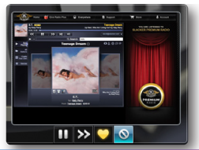
Preview Controls
Command Buttons
Control Without Launching
Social
Media
Notes:
DEMO
PostView.aspx
Check to see if we are on a post page (Line 4)
Make sure it is a pinned site (Line 10)
Create the thumbar (Line 11)
Add Digg button (Line 12)
Add Kick button
Open a post page
Hover over the taskbar icon
Click Digg
Click Kick

Slide 14
Google Analytics
Track as a campaign
One Line of HTML
<meta name=“msapplication-starturl” content=“/index.htm?utm_source=ie9&utm_medium=web&utm_campaign=pinned-ie9” />
Custom Report
Whitepaper Available
  Buildmypinnedsite.com

Slide 15
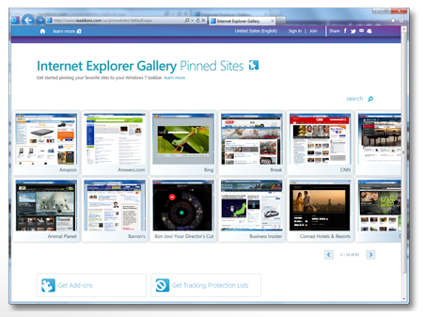
Gallery
Submit Your Site
ieaddons.com
Notes:
DEMO
Open site
Click see all pinned sites

Slide 16
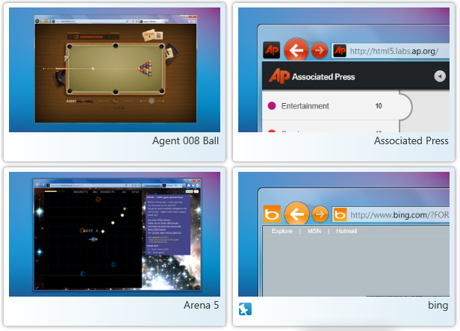
Beauty of the Web
beautyoftheweb.com
Notes:
DEMO
Open site
Amazing sites link on menu

Slide 17
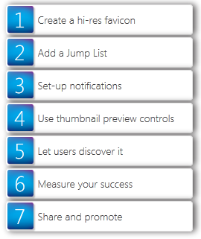
Build My Pinned Site
buildmypinnedsite.com
Notes:
Recently launched
DEMO
Open site
Show step by step to add pinning to your site

Slide 18
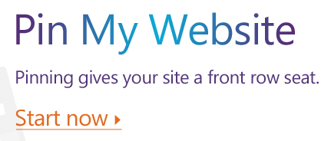
Pin My Web Site
pinmywebsite.com
Notes:
Generates:
Icon, Tasks, Dynamic List from RSS feed, Notification based on RSS feed, Notification Bar
DEMO
Open site

Slide 19
Contact Information
Geeks with Blogs - geekswithblogs.net/scottkuhl/
Twitter - @scottkuhl
Google - profiles.google.com/scottkuhl/
Email – scott@kuhl.ws
Deck and samples will be available on Geeks with Blogs

